Slide 1
Students’ inquiry and argumentation about carbon transforming processes Jenny Dauer, Hannah Miller, and Charles W. Anderson, Michigan State University Presented at the Annual Meeting of the National Association for Research in Science Teaching, Rio Grande, Puerto Rico, April 6, 2012 Website: http://edr1.educ.msu.edu/EnvironmentalLit/index.htm
Notes:
Welcome to our session

Slide 2
Definitions
Environmental science literacy is the capacity to understand and participate in evidence-based discussions of socio-ecological systems.
Learning progressions are descriptions of increasingly sophisticated ways of thinking about or understanding a topic
Notes:
These two basic definitions inform all of our work
I will elaborate on each

Slide 3
Practices of Environmentally Literate Citizens
Discourses: Communities of practice, identities, values, funds of knowledge
Explaining and Predicting (Accounts)
What is happening in this situation?
What are the likely consequences of different courses of action?
Investigating (Inquiry)
What is the problem?
Who do I trust?
What’s the evidence?
Deciding
What will I do?
Notes:
Now our approach to practices.
Our studies of how students at different levels of sophistication make environmental decisions have led us to identify 3 key practices:
Investigating, accounts, and deciding.
Inquiry and accounts—the yellow boxes—are particularly important to us as science educators.
My planned presentation will focus mostly on accounts, but I do have a few slides on inquiry tucked away at the end if you want to discuss inquiry during the question and answer session.

Slide 4
Two Kinds of Inquiry
First-hand inquiry (learning through your own investigations)
Second-hand inquiry (learning from claims made by other people or in the media)
Key questions in both kinds:
Who do you trust?
What evidence do you trust?
What arguments do you trust?
Notes:
The NRC Framework is notable for NOT having a separate “science and society” section. I think that one reason for this is that it accommodates a broader definition of inquiry, and it is the type indicated in the second bullet above that I want to address today.
SLIDE

Slide 5
Inquiry practices in a context: Carbon-transforming processes
Carbon-transforming processes in socio-ecological systems at multiple scales, including cellular and organismal metabolism, ecosystem energetics and carbon cycling, carbon sequestration, and combustion of fossil fuels.
Specific difficulties related to principles of conservation of matter and energy and atomic-molecular models
Notes:
For example: Using principles of conservation to show that Mass changes = atoms moving
2) What is meaningful to students when doing inquiry investigations? Results in specific important ways to revise our curriculum to connect inquiry to student explanations

Slide 6
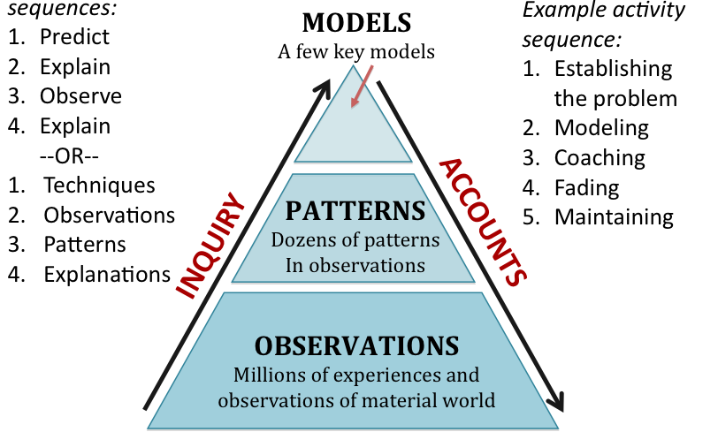
Two Types of Arguments from Evidence
Model-based arguments: Using models to explain patterns
Pattern-based arguments: Making observations and finding patterns
Notes:
Inquiry is what scientists do, it’s a complex set of practices… these are the particular practices that we focus on:
O-> P ->M
In comparison, an account is applying a theoretical model to explain or predict a phenomenon.
This is what we mean when we are talking about inquiry.

Slide 7
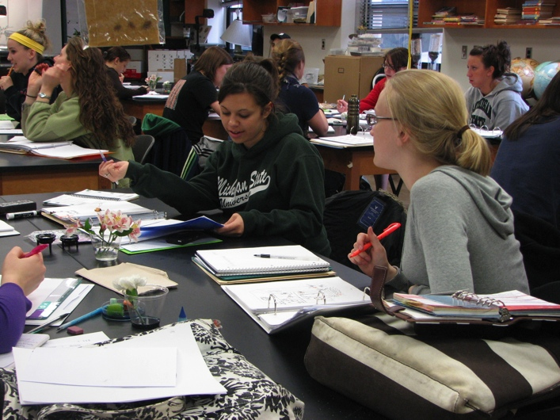
Research Populations
Middle School and High School students (n=150)
Undergraduates pre-service elementary school teachers at MSU (n=40)
Notes:
Data from 2 research populations.
In a science content class about matter and energy that covers astronomy, geology, climate, biology
Students have a non-science focus like history or language arts
Written and interview data inform this work– I’ll talk about interview data

Slide 8
Model-based Arguments: Karen and Mike Interview Question
Plants gain most of their weight from materials that came from nutrients in the soil.
Plants gain most of their weight from materials that came from the air.
Karen
Mike
Notes:
“We are interested in how people use evidence to support their ideas. We’re going to talk about two students who disagree with each other about how plants gain weight when they grow. One student Karen said: “The plant gains most of its weight from materials that came from the air.’
“Another student, Mike said: ‘The plant gains most of its weight from materials that came from nutrients in the soil.’
Student identifies the student they think is right and that’s where we start.

Slide 9
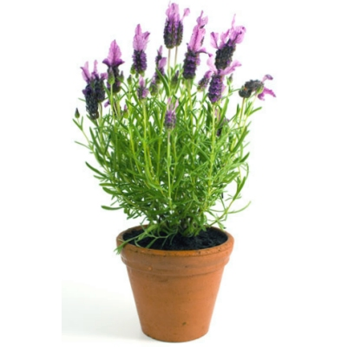
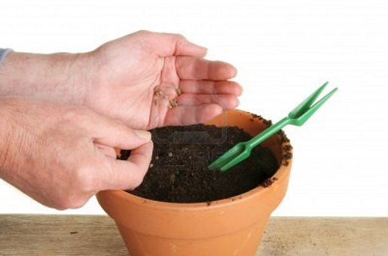
How does Karen’s argument support her idea that plant gains weight from materials that came from the air?
You can grow a big plant in a little pot without a lot of soil.
Seed = 1 g
Plant = 50 g
Soil = 80 g
Karen
Soil = 78 g
Seed planting
One year later
Notes:
Karen explains, ‘You can grow a big plant in a little pot without a lot of soil.’ Karen adds some evidence to her argument and explains ‘A seed weighing 1 g was planted in 80 g of soil. After two years the plant weighted 50 g and the soil weighed 78 g.’
“How does Karen’s argument support his idea that plants gain weight from materials that came from the air?”
“Are their some weaknesses in Karen’s argument? Explain what they are.”
What evidence would strengthen Karen’s argument?
So, the soil did not lose as much weight at the plant gained. Mass must come from a source other than soil.

Slide 10
Student response to Karen’s investigation
TEACHER: Well, what's the evidence that proves to you that she's right that plants gain their weight from air? JESS: The plant needs air to grow. TEACHER: Well how much did the soil lose? Eighty and 78, right? So, how many grams did the soil lose? JESS: Like 2. TEACHER: And how many grams did the plant gain? JESS: Like a lot. TEACHER: So, you think … what do you think? Do you think it came from the dirt? JESS: Yes, I do. I do because … I mean if the soil weighs like less now then I think the plant ate it all.
Notes:
The student Jess agrees with Karen’s claim, but she is substituting Karen’s real question and claim “the plant gains most of its weight from materials that came from the air” with a question more related to cause and effect: “What causes the plant to grow?” Jess’s claim and strategy for argumentation is more from her experience than from evidence: “the plants need air to grow.” The only relevant evidence is anything that connects the cause to effect, including other things that might cause the plant to grow, including “air” and “the sun next to a window.” So, even as the interviewer prompts Jess to reason using evidence, Jess does not, because the mass data are not relevant to the story what plants need to grow.

Slide 11
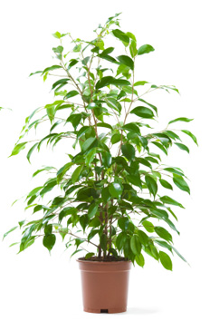
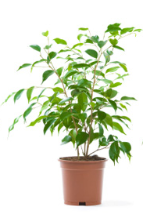
“How does Mike’s argument support his idea that a plant gains weight from materials that came from the soil?”
Plants have roots to take up nutrients from the soil to grow.
Plant grown without fertilizer
Plant grown with fertilizer
Plant = 50 g
Plant = 65 g
Mike
Fertilizer = 3 g
Notes:
Mike explains, ‘Plants have roots to take up nutrients from the soil to grow.’ Mike adds some evidence to his argument and explains ‘A plant grown with no fertilizer weighed 50 g, and a plant grown with 3 g of fertilizer weighed 65 g.’”
“How does Mike’s argument support his idea that plant gains weight from materials that came from the soil?”
“Are their some weaknesses in Mike’s argument? Explain what they are.”
What evidence would strengthen Mike’s argument?
Good responses to this question notice that the difference in weight between these two plants cannot be explained by only 3 g of added fertilizer. Scientific Inquiry framing of the purpose of this experiment is that the claim involves tracing matter or energy. Evidence is evaluated by reasoning: using an atomic-molecular models and principle of conservation to constrain the argument.

Slide 12
Student response to Mike’s experiment
TEACHER: Can you explain what Mike’s argument was? MABEL: His argument was that the plant was growing better with the fertilizer because it is—it has nutrients in it and it helps the roots grow and it takes the nutrients up through the roots and puts it towards the trunk of the tree. TEACHER: Okay. So, how does—how is Mike’s argument supported by this evidence? MABEL: It’s supported by the weight. He weighed it, one without fertilizer, and then, he added three grams of fertilizer and weighed it after the same amount of time and it grew more.
Notes:
Here the student, Mabel, substitutes the experiment’s real claim and question “the plant gains most of its weight from materials that came from nutrients in the soil,” with a different question that “what is the best approach to growing plants?” and the result is about “the plant was growing better with fertilizer.” Mabel is paying attention to the result somewhat– but only as a way to identify a winner… and this a satisfying result without reasoning using the mass data in a critical way accounting for matter using principles of conservation. So Mable did not notice that the plant’s increase in mass was greater than the mass of the fertilizer added.

Slide 13
What Are Jess and Mabel Doing?
Daniel Kahneman: When we are confronted with a question we can’t answer, we subconsciously substitute an easier question.
Jess and Mabel have altered Karen and Mike’s claims, and therefore their supporting evidence and reasoning.

Slide 14
Patterns in Student Arguments: Scientific Arguments
Claims are about tracing matter from environment to plant.
Conservation of mass is an important constraint.
Both arguments show flawed reasoning:
Karen: Evidence shows mass doesn’t come from soil, but not that it does come from air
Mike: Evidence actually contradicts claim

Slide 15
Patterns in Student Arguments: Naïve Inquiry (e.g., Jess)
Claims are about what plants need to grow.
Both Karen and Mike could be right.
Evidence includes both what Karen and Mike said and personal experience

Slide 16
Patterns in Student Arguments: Naïve Engineering (e.g., Mabel)
Claims are about the best way to get a plant to grow.
Evidence shows that Mike had the better experiment
Karen didn’t even try to change the air, so she didn’t show anything about the effects of air on plant growth
Mike showed that soil nutrients make plants grow better

Slide 17
Patterns in Student Arguments: School Science Inquiry
Claims are the right answer (usually Mike)
Evidence: the right answer comes from an authoritative source
Critique of Karen’s and Mike’s arguments focuses on procedural concerns peripherally connected with Karen’s and Mike’s reasoning: How many pots, measured how often, controlling variables, etc.

Slide 18
Two Types of Arguments from Evidence
Model-based arguments: Using models to explain patterns
Pattern-based arguments: Connecting observations with patterns
Notes:
Inquiry is what scientists do, it’s a complex set of practices… these are the particular practices that we focus on:
O-> P ->M
In comparison, an account is applying a theoretical model to explain or predict a phenomenon.
This is what we mean when we are talking about inquiry.

Slide 19
Pattern-based Arguments
Who are you going to believe, me or your own eyes? Chico Marx in Duck Soup.
Scientific inquiry: Believe data to the limits of accuracy and precision. Your own eyes may not be accurate or precise.
Naïve inquiry: Believe your own eyes; data may not add much to the totality of your experience.
Naïve engineering: Your own eyes will tell you the winner.
School science: If your own eyes see an incorrect result, you did it wrong.

Slide 20
Conclusions
We have a start, but not a learning progression
Alternatives to scientific argumentation don’t seem to be hierarchically organized
Most students aren’t very good at scientific arguments from evidence, but they aren’t trying to be good.
We have some work to do on when and how arguments from evidence are valuable.

Slide 21
Thanks to Funders
This research is supported in part by grants from the National Science Foundation: Learning Progression on Carbon-Transforming Processes in Socio-Ecological Systems (NSF 0815993), and Targeted Partnership: Culturally relevant ecology, learning progressions and environmental literacy (NSF-0832173), CCE: A Learning Progression-based System for Promoting Understanding of Carbon-transforming Processes (DRL 1020187), and Tools for Reasoning about Water in Socio-ecological Systems (DRL-1020176). Additional support comes from the Great Lakes Bioenergy Research Center. Any opinions, findings, and conclusions or recommendations expressed in this material are those of the author(s) and do not necessarily reflect the views of the National Science Foundation or the United States Department of Energy

Slide 22
Thanks to Contributors to this Research
Jing Chen, Li Zhan, Jonathon Schramm, Jennifer Doherty, Amy Lark, Dante Cisterna, Jenny Dauer, Jiwon Kim, Hannah Miller, Staci Sharp, Courtney Lannen, Kathryn Oleszkowicz, Etiowo Usoro, Allison Webster, Liz Thompkins, Melissa Janos, Michigan State University
Laurel Hartley, University of Colorado, Denver
Cornelia Harris, Cary Institute for Ecosystem Studies
Hui Jin, The Ohio State University
RET’s: Marcia Angle, Lawton Schools, Rebecca Drayton, Gobles Schools, Cheryl Hach, Kalamazoo Math & Science Center, Liz Ratashak, Vicksburg Schools, Debi Kilmartin, Gull Lake Schools
Mark Wilson, Karen Draney, Jinnie Choi, and HyoJeong Shin at the Berkeley Evaluation and Assessment Research Center
Notes:
I want to thank the many people who have contributed to this research, and I’m open for questions.

Slide 23
Thank you!
Please visit our website:
http://edr1.educ.msu.edu/EnvironmentalLit/index.htm

